Slide 1
University of Louisiana System Fellows Program:
Collaboration for More Robust Data Analysis
Kelsey Claspill, IR Data Analyst
Blake Robért, Data Warehouse Analyst
Notes:
Lisa - Introduction for what the UL system is, total enrollment, etc

Slide 2
Today’s Presentation
Data Fellows Program
Project Information
Notes:
Dawn – Overview structure of presentation

Slide 3
Purpose of Establishing Fellowship at UL System
Retain talent by exposing our analysts to high-level systemic projects
Increase collaboration systemwide. Our data analysts represent our regional and statewide institutions.
Strengthen peer review process by reviewing projects at several levels – internal team, system, institutional researchers across system.
Shared resources for systemwide use. Deliverables include dashboards and other resources that can be utilized by all system schools.
Notes:
Dawn – History of collaboration among institutions

Slide 4
Responsibilities for Data Fellows
System-level data analysis
Data visualization with drilldown capabilities
Statistical analysis
Collaboration and continuous learning
Assist with building reusable data structures
Notes:
Lisa

Slide 5
Milestones of Fellowship Work
Initial Collaboration
Sep – Dec 2023
Dual Enrollment Dashboard
Dec 2023
Collaboration
Jan 2024
Retention/Graduation Dashboard
Feb 2024 - present
Share with Peers
July 2024
Identify two projects
Formalize project charter/definition process
Peer reviews
Presentation to ULS Board of Supervisors
ULS Needs survey
Dash development
Review Project 1
Data acquisition
Pivot to new Project 2
Project Charter agreed
Team and IR Peer review
Incorporate ideas from Proj 1
Review feasibility of original Project 2
LAIR Presentation of Fellows process
Data acquisition
Overall Planning
Notes:
Dawn

Slide 6
Ground Rules for Projects
Each project must mutually benefit:
the UL System Office,
the Data Analyst Fellow’s home institution, and
two or more institutions within the UL System
A Project Charter must be completed and agreed on for each project.
Must be peer-reviewed
Must culminate in a Board Development session
Notes:
Lisa

Slide 7
Project Charter for Dashboard Development
Dual Enrollment Study
Research Question – “Where do UL system preparatory students go?”
The purpose of this project is to produce the first iteration of a dashboard to promote the analysis of ULS member institutions’ dual enrollment. The project deliverable should provide insights into where students attend following dual enrollment at a ULS member institution.
Notes:
Discussions at the UL System regarding enrollment trends of high-school dual enrollment students.
The system had an interest in measuring the effectiveness, performance, and tendencies of students who participated in high school dual enrollment programs compared to students who did not.

Slide 8
Project Planning
October
Meeting with UL System President
Early November
Retreat with Fellows Team
Presentation Development
Mid-November
Planning Meeting with UL System Senior Staff
Dashboard Review
Late November
Presentation to UL Lafayette Leadership
Demo to UL System IR
UL System Board Development
Presentation to UL System Board of Supervisors and University Presidents
December
Timeline for Dual Enrollment Study
Notes:
Timeline to develop this dashboard was quite tight, as we had just under two and a half months in total from October to early December to plan and develop the product.
We had some meetings in October and early November to talk about what was needed and help plan the scope of the project.
By Mid-November we had some preliminary data and talked with senior staff about next steps.
At the end of November we had presented the data internally to UL Lafayette Leadership, as well as opened it up for feedback from UL System IR offices.
And by early December we presented the final dashboard to the UL system board and opened up access.
Next few slides I'll talk about how I approached the planning for the project, as well as the tools and technologies used to complete it.

Slide 9
Dual Enrollment Study
Project Planning - Defining Scope and Goals
Questions posed during initial discussions:
Where do UL System Dual Enrollment students go?
Do they continue in the system, in state, out of state?
What types of institutions do they go to?
Percent that continue?
How does this differ by Pell eligibility, race, gender, or parish?
What majors do they enter into?
How do they perform compared to Non-Dual Enrollment Students?
Notes:
When we first sat down in October I worked with staff to come up with a set of questions that they would like answers to.
I usually start with a preliminary meeting like this to help identify scope and give me a starting point for my research.
Once you get an exhausted list of questions you can then focus the scope to what is reasonable or possible
with existing deadlines or restrictions before starting work.

Slide 10
Dual Enrollment Study
Project Planning - What can realistically get done?
Not everything can be answered...
How does this differ by Pell eligibility, race, gender, or parish?
Couldn’t pull out Pell eligibility with data that was available.
How do they perform compared to Non-Dual Enrollment Students?
Limited years of data resulted in lack of available performance metrics.
Notes:
Not everything can always be completed with what's available!
Restrictions on what's available in your data sources may make some questions unanswerable...
in this case we did not have access to course or financial aid information. Did not have access to grades for performance or Pell-eligibility.
Timing or length of available data may make some calculations unreliable or unrepresentative of reality...
In this example we only had four years of data of college enrollment, calculating 4-year graduation rates for a single cohort was not optimal.
It's best to inform the stakeholders as soon as possible on what is possible and not possible.
I usually try to discover and communicate this information within a week of the initial meeting.

Slide 11
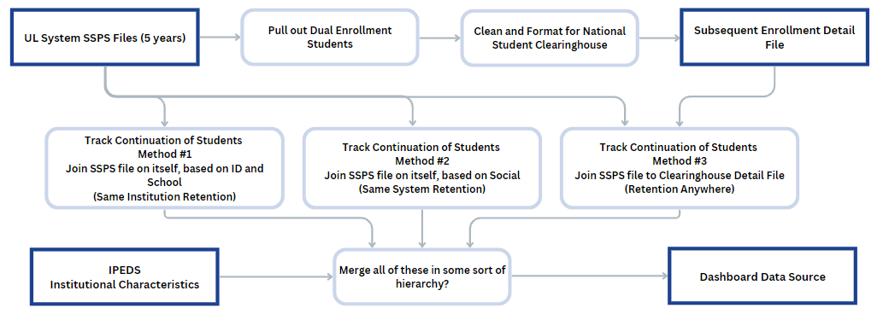
Dual Enrollment Study
Project Planning - Sketch it Out!
Before doing any coding or dashboarding I had this...
Notes:
Before I begin work I like to sketch out my steps at a high level.
Doesn’t have to contain all the details.
What I've found to be the most important is having a good understanding to what’s involved in the connections...
For example, I knew that I could generate a clearinghouse file from the SSPS files, and I knew that I could merge SSPS, Clearinghouse, and IPEDS using shared institution and `
student identifiers.
Having this outline (along with the list of questions from preliminary meetings!) to reference back to helps me define milestones, complete features, and provide incremental updates to stakeholders.

Slide 12
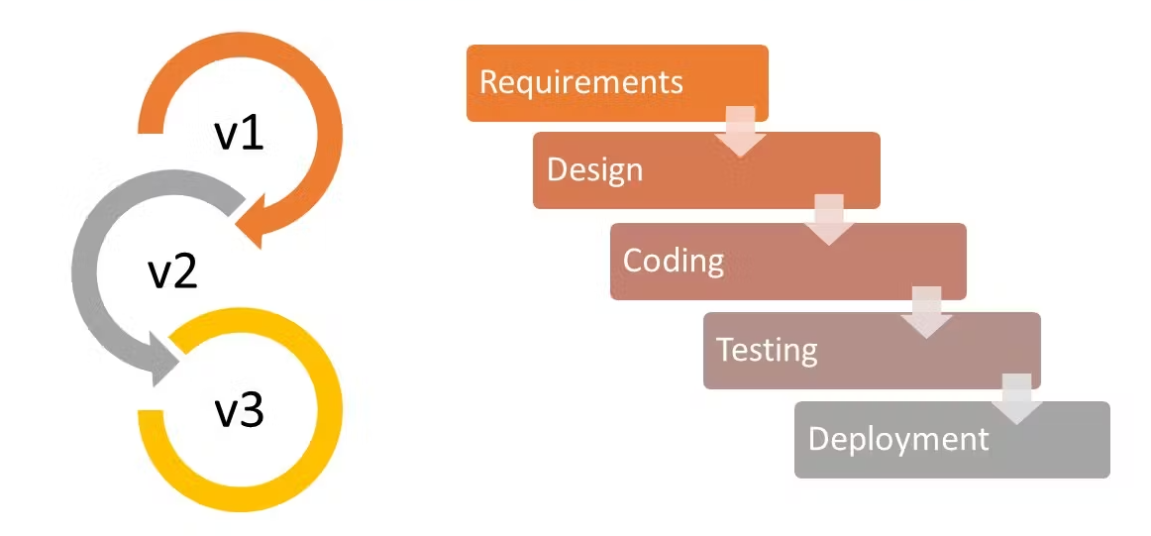
Dual Enrollment Study
Project Planning – Tips for Success
Develop in iterations and strive for self-sufficient checkpoints
Check your work each step of the way
Don’t spread yourself too thin working on multiple features or tasks
Notes:
Before I move on to the data sources and technologies I wanted to share just a few tips to success...
Develop in iterations - Allows you to have points where you can share progress or get solid feedback before the project’s completion.
I was sharing charts and numbers each time I generated a new set of metrics. When I was making the dashboards I would finish one view before moving on to the next.
Check your work each step - Everyone makes mistakes, and it’s best to catch issues early on before you build on top of them.
It's much easier to know exactly what step broke something before you're 10 steps in and trying to guess what went wrong.
When I'm coding, I'm checking the output of the data set each time I make major change, like new calculations or joins.
Checking for empty values, duplicated, or mismatched data, or unexpected changes in total counts of records.
When I'm dashboarding, this is double checking totals, manually calculating and comparing to what is displayed in the visualizations.
Spreading yourself thin – When possible, especially for dashboarding, work on a feature and complete it before working on another feature.
Looking at your initial scope questions, finish one question before moving on to the next.
If the floor gets pulled out from under you for whatever reason, you'll have some completed work rather than nothing!

Slide 13
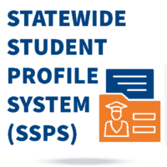
Dual Enrollment Study
Data Sources (1/2)
SSPS Data Extract for UL System Schools
Five years of data (2018-2023) provided by BoR
NSCH Subsequent Enrollment Detail File
Generated by NSCH's StudentTracker Program
Notes:
At the core of the study was two datasets:
The first one was the SSPS Data, which was a combination of all UL System School's SSPS submission files from 2018-2023.
This file was used to identify the dual enrollment students and also track continuation in-system.
The second was the NSCH file. It's a file that is returned from the Subsequent Enrollment Query of NSCH's StudentTracker Program.
It contains records of enrollment, with dates of enrollment for submitted students.
Using this file made it possible to get all enrollment records (on a national level) for the Dual Enrollment Students from 2018 onward.
This file was used to supplement student’s continuation rates, especially for outside-of-system schools.

Slide 14
Dual Enrollment Study
Data Sources (2/2)
IPEDS Institutional Characteristics
Pulled from IPEDS Access Database, HD Table
CIP Codes file from 2010 and 2020
Pulled from NCES Website
SSPS Homes List
Pulled from BoR SSPS Specs
Notes:
Some additional data sources were used to supplement the SSPS and NSCH files.
These were used to provide additional details and descriptions on students, their programs, and the institutions they attended.
CIP Codes - (Classification of Instructional Programs) - Used to convert CIP codes to their titles and descriptions.
IPEDS Institutional Characteristics - Used to pull various details about institutions (State, Public/Private, Highest Degree offered, etc.)
SSPS Home List - Codes and Descriptions of available homes, Used to determine home location of DE students. (Appendix B, C, and D – at the end of the specs)

Slide 15
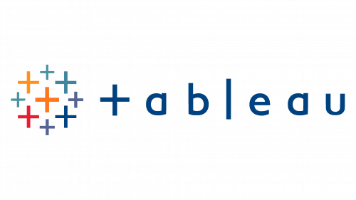
Dual Enrollment Study
Tools Used (1/2)
Tableau – Used for Dashboard Development
Python – Used to split the large SSPS CSV file into chucks so it could be opened on laptop and inspected before loading into Postgres.
Excel – Used for data exploration while building out dashboard data source.
Notes:
Tableau was utilized due to having prior experience and it is the existing visualization tool for the UL System.
But before building out the dashboard I had to get the data into a proper and easily workable format.
Python was used to split the initial SSPS CSV file into smaller files. It was far too large to be opened by excel or a text reader.
I had to look at the data types and contained data before designing tables so I could load it into a database.
Excel played a supporting but very important role in the process.
I used Excel to inspect SQL query outputs as I expanded the query to add new features - a way for me to spot check my logic and make sure everything was being generated and joined as I intended.

Slide 16
Dual Enrollment Study
Tools Used (2/2)
Postgres – Used Postgres for SQL development, being able to easily join and manipulate data files together.
Microsoft Access – to export IPEDS Institutional Characteristics Table.
National Student Clearinghouse’s Student Tracker – Utilized the detail file from the Subsequent Enrollment Query to see where students had gone after graduating from high school.
Notes:
Postgres is an open source (free, no license) database system. Utilized it for SQL development since the System did not have an existing database.
If I had to do it again, I would probably use DuckDB rather that Postgres. DuckDB is an in-memory database and allows you to write SQL code directly on excel and CSV files.
DuckDB performs really well, even with huge files, and it avoids the overhead of creating tables and other database objects.
Microsoft Access played a minor role in that it was the easiest way to export the institutional characteristics table to an Excel file and then upload it to the Postgres database.
NSCH's Student Tracker tool was very important. Without it, we wouldn't have been able to see any continuation data outside of the system.

Slide 17
Dual Enrollment Study
Technical Challenges
Large Files - 5 Years of UL System SSPS data was too large to open in a traditional program like Excel or a Text Editor.
Messy Data - Missing values, special characters, duplicate records across institutions.
Complicated Structure - It ended up being about 15 different joins between the SSPS and clearinghouse files to track continuation rates for three years.
Timing - Tracking students over academic years proved difficult due to varying granularity of data.
Notes:
Large Files
The 5-years of UL System SSPS data was too large to open in excel, a text reader, or anything that relied on loading the entire file into computer memory.
I ended up splitting it using Python initially so I could open and inspect the data fields.
After I could do that, I loaded it into a local Postgres database in order utilize SQL and perform filtering, cleaning, and joining.
Messy Data
SSPS had missing birthday values and names with special characters which couldn’t be used with the clearinghouse.
Clearinghouse had different enrollment statuses and dates for each institution, and introduced potential duplicates at the level of detail the analysis was being run on.
Complicated Structure
To fully utilize clearinghouse required joining the data multiple times.
It ended up being about 15 different joins between the SSPS and clearinghouse files to track continuation rates for three years.
Timing
SSPS is broken down by terms for each institution. Clearinghouse file was broken down by institution and date (With potentially many records within a term's timeframe)

Slide 18
Dual Enrollment Study
Non-Technical Challenges
Managing expectations between stakeholders at UL Lafayette, the UL System, and other institutions was difficult.
Additional projects and requests came from demonstrations
Deadlines were tight and required some features to be cut.
Discussions and follow-ups to dashboard occurred daily during November.
Notes:
Managing expectations and overall goals across UL, the system, and other institutions was difficult.
During our preliminary demonstrations or discussions of the dashboard, additional requests or projects were spun up.
These request often fell outside of the initial scope or timeline of the project.
Deadlines were tight - The project had to be finished for Board Development in December. From start to finish it was about two and a half months.
On top of the development, we needed to get the work and dashboard reviewed and approved by internal stakeholders before finalizing for the system.

Slide 19
Dual Enrollment Study
Benefits Gained
What did UL Lafayette Gain?
Better understanding and access to the status and outcomes of our dual enrollment students. Data to support discussions and changes in procedures around dual enrollment recruitment, course offerings, and student preparations.
What did the UL System Gain?
Better understanding of the dual enrollment trends across Louisiana. Access to in-depth dashboard on an institution-by-institution, and overall system, level.

Slide 20
Project Charter for Dashboard Development
Retention/Graduation Study
Research Question – “Do students who start in the UL system stay in the UL system?”
The purpose of this project is to produce the first iteration of a dashboard to promote the analysis of ULS member institutions’ retention and graduation of undergraduate students. The project deliverable should provide insights into persistence (i.e., retention and graduation) trends over time in relation to individual institutions, across the system, statewide, and out of state.
Notes:
Dawn -

Slide 21
Retention/Graduation Study
Project Planning - Expansion
Expansion of existing dashboards reflecting retention and graduation at the institutional level
Process reused, but with different data for a different scale
NSU Dashboard
System Dashboard
Data
Internal Enrollment Data
Internal Completer Data
Measures
In Major
In Department
In College
In Institution
Data
SSPS
Completers
Student Tracker File
Measures
In Institution
In System
In State
Out-of-State
Notes:
Dawn Overview -
Mention NSU dashboard – inspiration
Second question naturally leads into the next slide on data

Slide 22
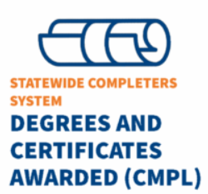
Retention/Graduation Study
Data Sources
SSPS Data Extract for UL System Schools
10+ years of data (2012-2023) provided by BoR
NSCH Subsequent Enrollment Detail File
Generated by NSCH's StudentTracker Program
Completers Data Extract for UL System Schools
10+ years of data (2012-2023) provided by BoR
Notes:
Additional years available by time project started
Also used StudentTracker graduation data
Completers data also became available

Slide 23
Graduation/Retention Study
Tools Used
Tableau Prep – Used for Data Preparation
Tableau – Used for Dashboard Development
NSCH Student Tracker – Utilized the detail file from the Subsequent Enrollment Query to see where students had gone after leaving the UL System
Colblindor’s Color Blindness Simulator – Used to test dashboards for color blind accessibility
Notes:
Prep instead of SQL, Python, and Excel
Converted data to Tableau.hyper file, runs faster than Excel file

Slide 24
Colblindor – Before and After
Original Image
Image with Red-Blind/Protanopia
Notes:
Prep instead of SQL, Python, and Excel
Converted data to Tableau.hyper file, runs faster than Excel file

Slide 25
Retention/Graduation Study
Project Planning - Defining Scope and Goals
Questions posed during initial discussions:
At what rate are UL System students retained at their original institution?
If not retained, do they continue in the system, in state, out of state?
What types of institutions do they go to?
How does this differ by Pell eligibility, race, gender, or parish?
What majors do they transfer into?
Notes:
Institution vs System vs In-State vs Out-of-State
Filters for demographics, parameters for timeframes, calculations, tooltips for institution info, actions
Tooltip selection of 2-yr/4-yr/pub/private

Slide 26
Retention/Graduation Study
Project Planning - What can realistically get done?
Not everything can be answered...
How does this differ by Pell eligibility, race, gender, or parish?
Couldn’t pull out Pell eligibility with data that was available.
How does this differ by field of study?
More analysis needed for aligning majors.

Slide 27
Retention/Graduation Study
Project Planning – Tips for Success
Leverage work you have already done
Leverage work others have already done
Seek feedback early and iteratively
Notes:
Existing NSU retention/grad rates dashboard
Help from Blake on formatting SSPS files and dashboard
Multiple rounds of feedback

Slide 28
Retention/Graduation Study
Technical Challenges
Large Files! 10 Years of UL System SSPS and Completers data caused Tableau Prep to execute more slowly
Combining Data Sources! Decisions about the best way to sync data across sources from varying time windows.
~50 steps, including 7 joins, some with up to 12 changes
Complex Calculations! Data structure best suited to project required some intricate Level of Detail (LOD) calculations.
~100 total calculations, not including the prep stage
Notes:
Talk about transformation of data sources due to SSPS being based on one set of time structures and Completers based on a year. Then neither of those was actually used to create the relationships.

Slide 29
Retention/Graduation Study
Non-technical Challenges
Completers Data was not available until March.
Focused work on first-year retention and structures needed for out-of-system and out of state metrics
Agenda for ULS and Board continued to fill up, pushing demonstration to later times.
Further time for evaluation, refinement, testing.
Scope Creep occurred, with multiple features being added progressively
Combined retention/graduation dashboard à added tooltips for extra detail à split dashboards à 2nd retention view à added navigation features à added additional transfer info
Notes:
Opportunity to incorporate FA23 SSPS data

Slide 30
Retention/Graduation Study
Benefits Gained
What did Northwestern State Gain?
Experience working with larger datasets
Skills in using dashboard actions, allowing users to have more intuitive navigation
Better understanding of where non-retained students enroll
What did the UL System Gain?
Better understanding of retention trends across Louisiana. Access to in-depth dashboard on an institution-by-institution, and overall system, level.

Slide 31
Vision for Data Fellows at UL System
Are we on the right track?
“Our data analysts have been pivotal in cultivating a robust data culture with the UL System. We believe this approach has significantly enhanced the speed and effectiveness of our decision-making in critical areas, propelling us toward greater efficiency and success.”
– Dr. Claire Norris, Vice President for Advancement, University of Louisiana System
Notes:
Lisa

